Slide 1

Global Heart of Peace Sponsored
Season of Peace and Nonviolence
Week 2

Slide 2
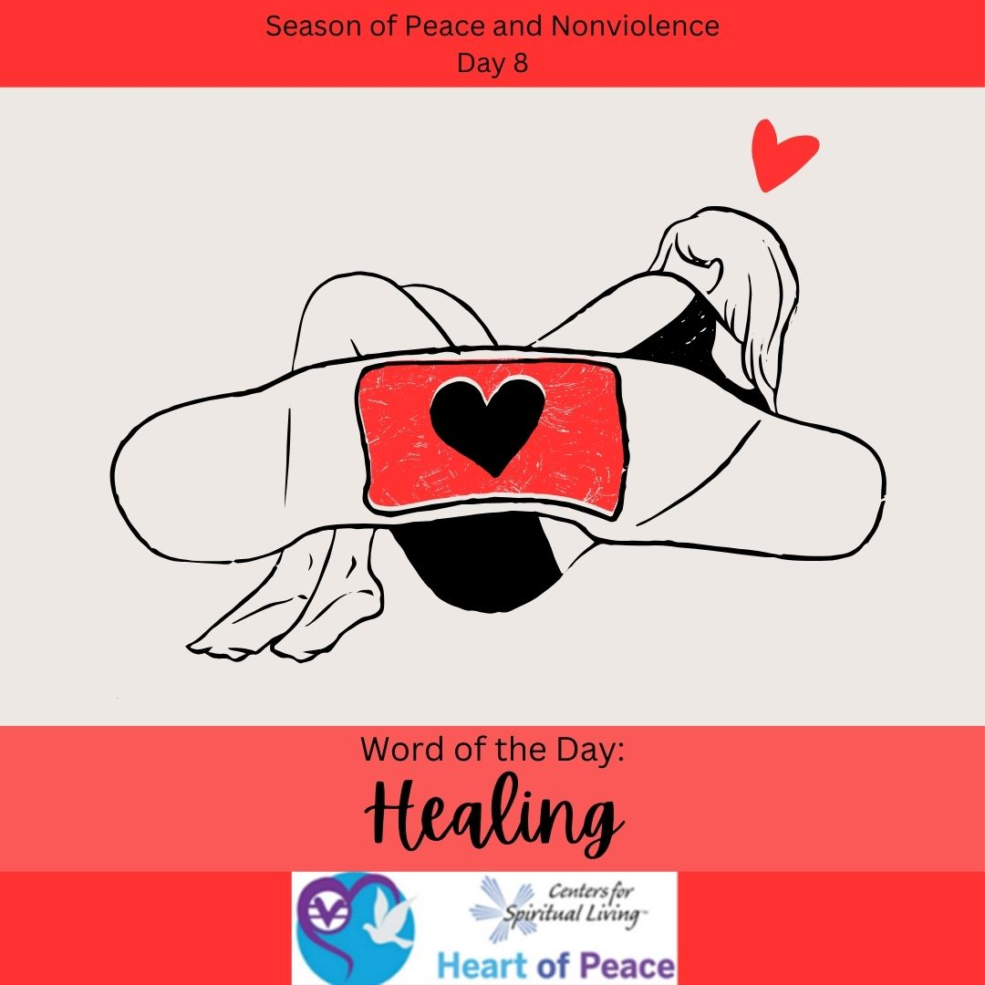
Day 8: Healing
Why is healing important?
What area in your life are you resisting healing?
How does the idea that healing is revealing feel to you?
What steps are you willing to take to heal the difficult wound you’ve been avoiding?

Slide 3
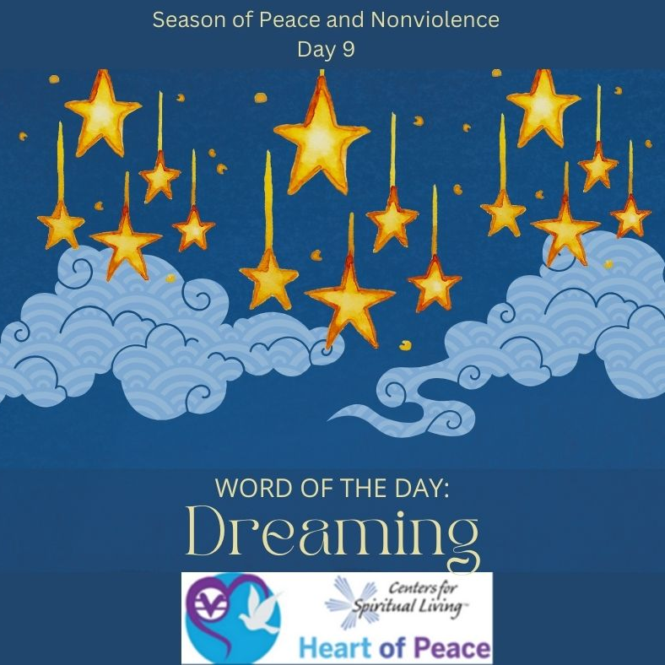
Day 9: Dreaming
What gets in the way of you dreaming?
If you could create anything in your life that you wanted to, what would it be?
Think back to being a child when you dreamed big, what was your biggest dream? What stopped you from achieving it?
What benefits can you gain by starting to dream again?

Slide 4
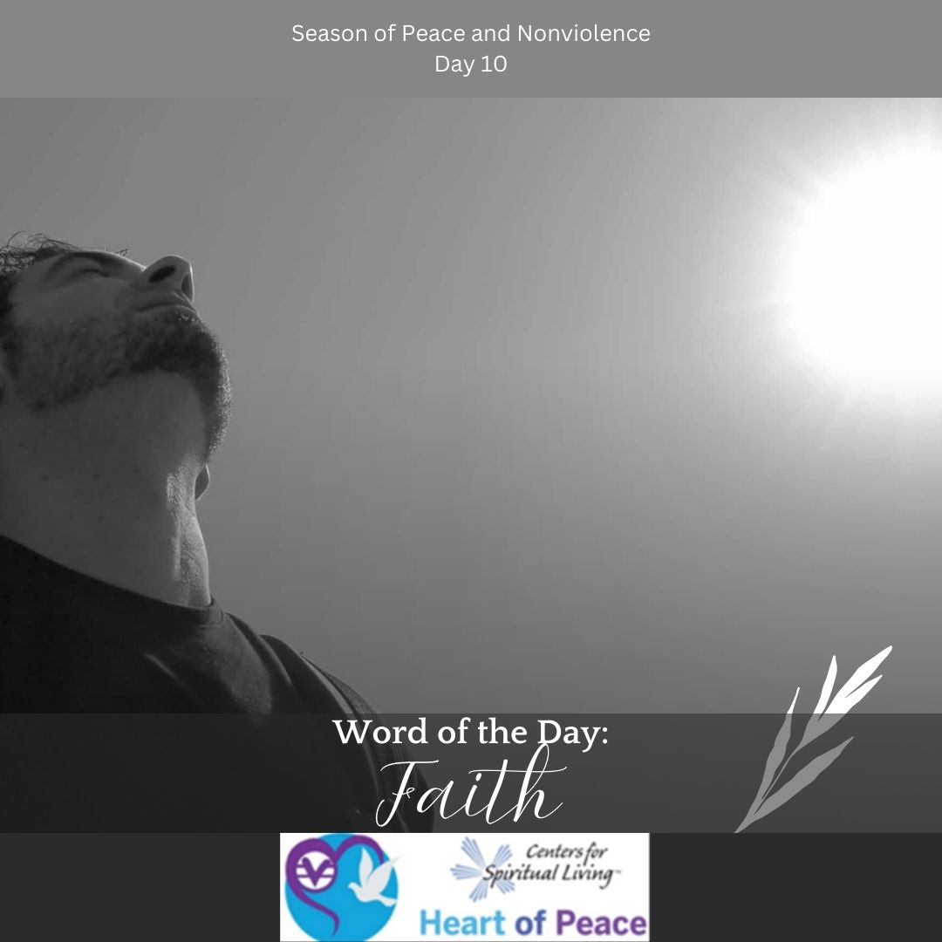
Day 10: Faith
What does faith mean to you?
What struggles do you have with your faith?
How do you feel about people who have different faith than you?
How open are you to learning about faith and what it means to people who believe differently than you?
What steps are you willing to take to grow your faith?

Slide 5
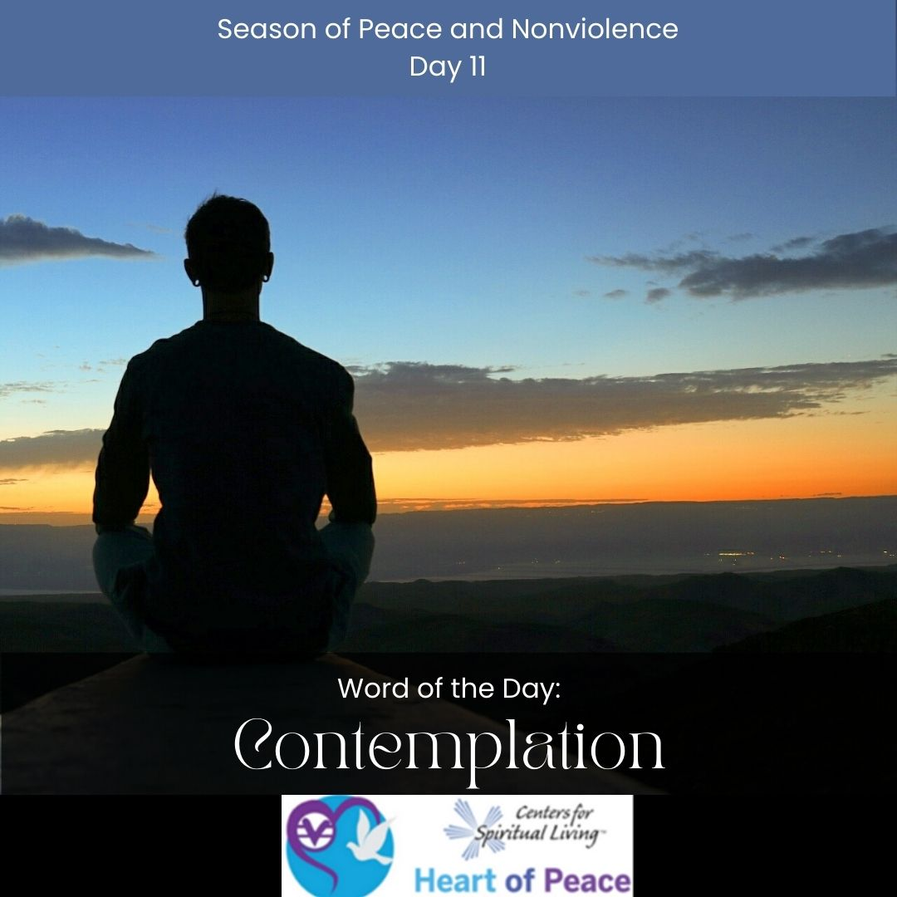
Day 11: Contemplation
Is contemplation easy for you?
How is contemplation different from dreaming?
When in contemplation, do you focus on the positives or the negatives? What happens if you shift your contemplation to only the positive?
How can you commit to bringing more contemplation into your life?

Slide 6
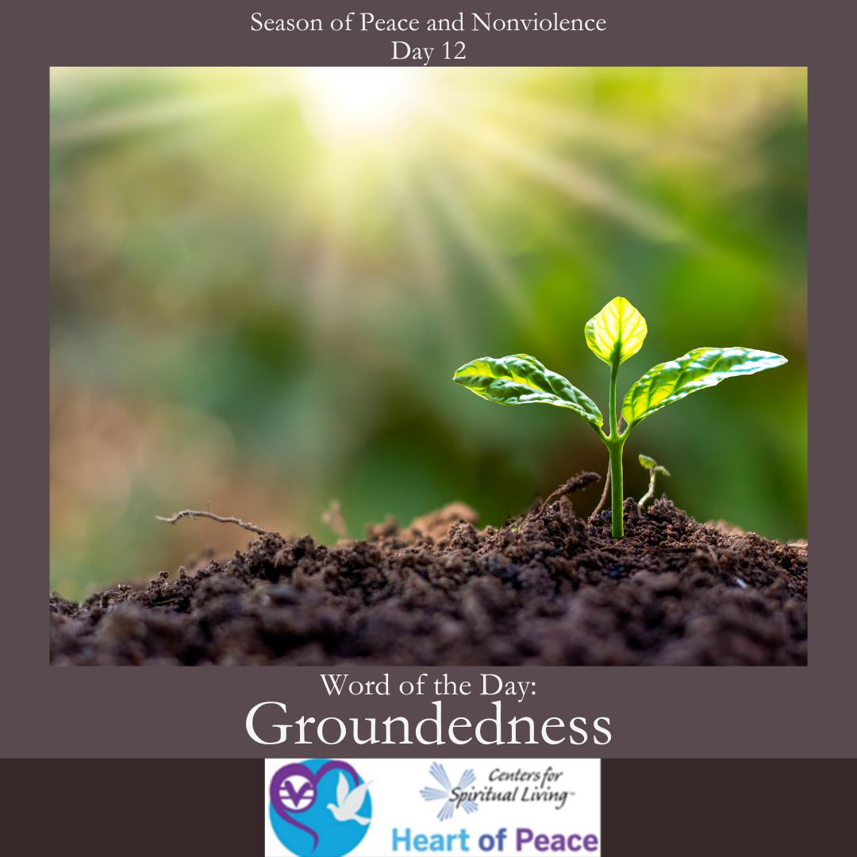
Day 12: Groundedness
How do you know when you are grounded?
What benefits do you feel when you are grounded?
How does being grounded affect your relationships?
What steps are you willing to take to become more consistently grounded?

Slide 7
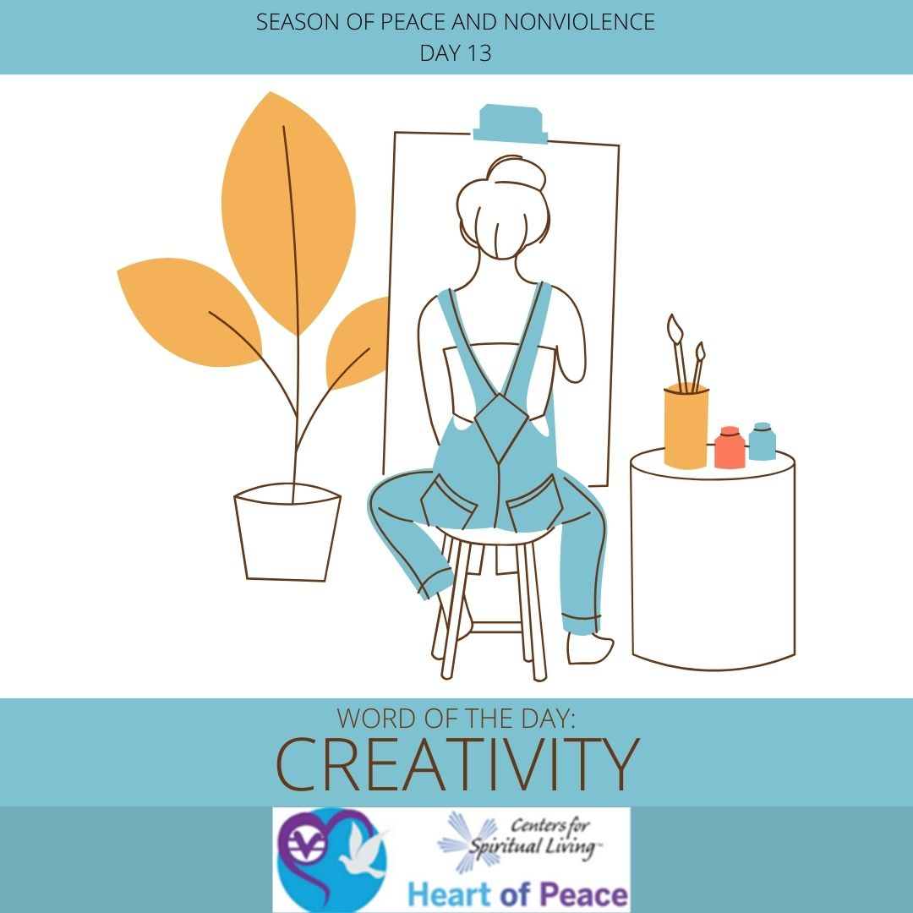
Day 13: Creativity
What does creativity mean to you?
Where in your life could you use more creativity?
What types of creativity are most important to you?
What steps are you willing to take to remove any blocks surrounding your creativity?

Slide 8
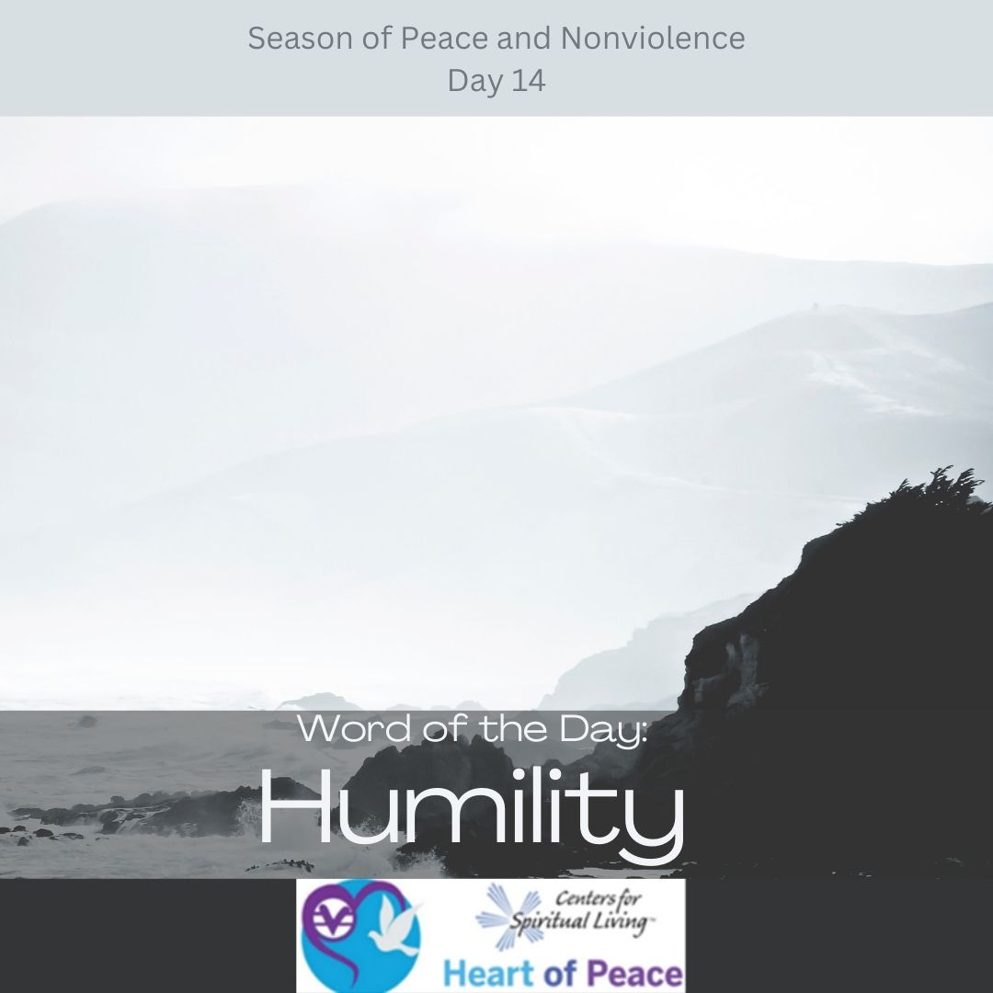
Day 14: Humility
What characteristics best exemplify true humility?
How do you balance humility with confidence?
Why is humility important in your relationships with others?
What is most important to you about humility?

Slide 9
Summary Questions
How do this week's words apply to peace and nonviolence?
What challenges do this week’s words bring up for you?
What words do you feel you need to spend more time with?
What would help you most in incorporating these words in your life?

Slide 10
Week 2 Words- Added Resources
Day 8 – HEALING (Feb. 6) -Everything happens for a reason. Think of ways you have grown and matured from challenging experiences in your life.
Day 9 –DREAMING (Feb. 7)-Dreaming is the first step to doing. Today, don’t only dream of peace. Live it.
Day 10 – FAITH (Feb. 8)-We all have obstacles in our lives, however big or small. No one’s life is better or worse than any other’s. What always gets us through is faith: the faith that with every closed door is an open window. Today have faith.
Day 11 – CONTEMPLATION (Feb. 9)-Today, we will practice contemplation. When you close your eyes and breathe, relax and think about the positive things in your life right now. Then open your eyes and write down your good thoughts.
Day 12 – GROUNDEDNESS (Feb. 10)- Gandhi said, "To forget how to dig the earth and tend the soil is to forget ourselves." When we are angry with ourselves, we can't see things clearly. Today we should let go of our grudges against others and ourselves, so we can be grounded in our lives, and really feel our experiences.
Day 13 – CREATIVITY (Feb. 11)- Every day we are creative without even realizing it. We put on make-up, or do our hair, or go through work in a fog. Today let’s all take some time to create something to express our feelings.
Day 14 – HUMILITY (Feb. 12)-Making mistakes is a part of our day-to-day lives. Why don't we change our views on humility and start focusing on learning from our mistakes instead of dwelling on them. Today think of a past mistake and take the time to truly think about what you learned from it and why.
Document Source: Microsoft Word - 64-Daily_Practices-TEENS.doc

