Slide 1

Global Heart of Peace Sponsored
Season of Peace and Nonviolence
Week 3

Slide 2

Day 15: Reverence
What does it mean to have reverence?
How do we focus on reverence no matter what the situation is?
Why is it important to have reverence?
What steps can you commit to making to make reverence more important in your life?

Slide 3
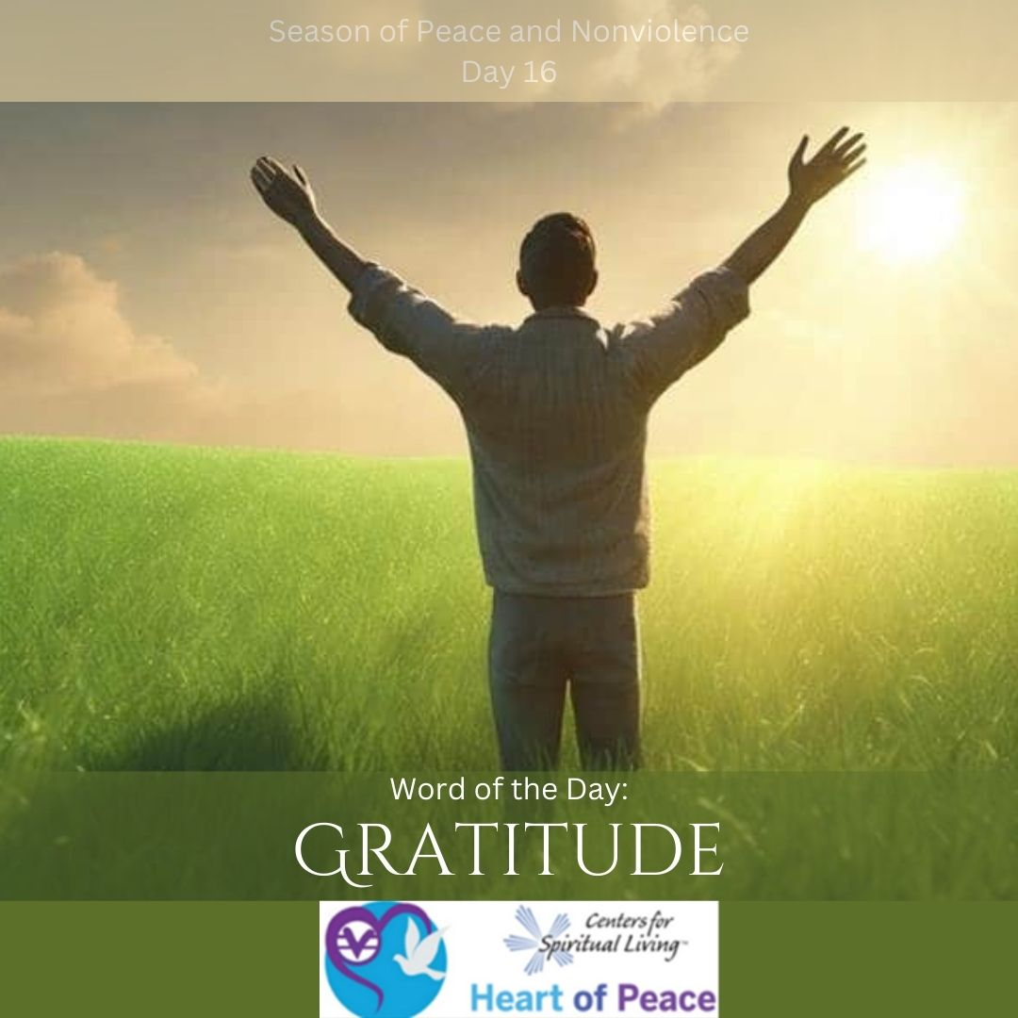
Day 16: Gratitude
What are you most grateful for?
Gratitude is easy when things are going well. What steps can you take to practice gratitude for the lessons and challenges you face when life gets hard?
What affects can having gratitude through the hard times have on your life?
How can your relationships improve with a focus on gratitude?

Slide 4

Day 17: Integrity
What does integrity mean to you?
Is it possible to have integrity and not be a good person or do bad things?
How do you handle when someone is acting out of integrity?
How do you feel when you act out of integrity?

Slide 5

Day 18: Freedom
Does anyone truly experience freedom?
What does it feel like to have freedom?
How do you share freedom?
What aspects of freedom are most important to you?
How do you experience more freedom in your life?

Slide 6

Day 19: Acceptance
What is the hardest thing to accept about yourself?
What is the hardest things to accept about others?
Why is it important to practice acceptance?
What steps are you willing to commit to in order to practice accepting yourself more?

Slide 7
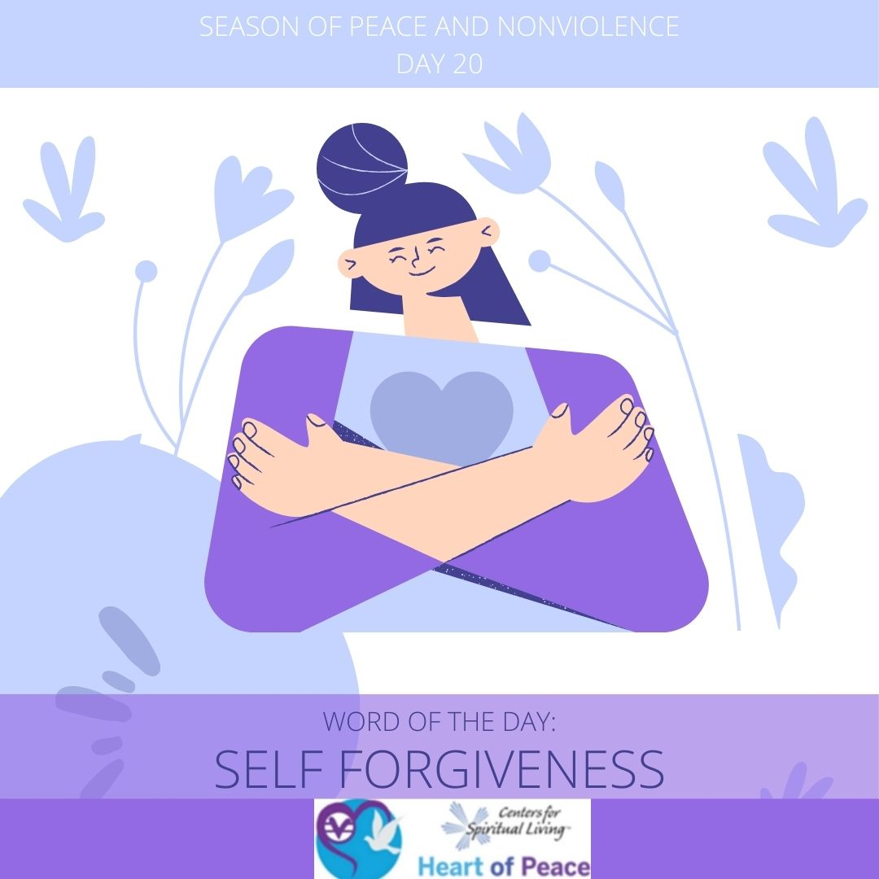
Day 20: Self- Forgiveness
Where in your life do you find it hardest to forgive yourself?
Can you forgive yourself without changing your opinion about what happened?
What benefits will you experience if you forgive yourself?
What steps can you take today to increase your self-forgiveness?

Slide 8

Day 21: Inspiration
What inspires you most?
What do you feel like when you are inspired?
Where in your life are you feeling blocked or like you need more inspiration?
How do you turn inspiration into action?

Slide 9
Summary Questions
How do this week's words apply to peace and nonviolence?
What challenges do this week’s words bring up for you?
What words do you feel you need to spend more time with?
What would help you most in incorporating these words in your life?

Slide 10
Week 3 Words- Added Resources
Day 15 – REVERENCE (Feb. 13)- Did you ever see something that took your breath away? Today we focus on how beautiful our world is, and how beautiful we are. Let's not focus on the negative.
Day 16 – GRATITUDE (Feb. 14)- Life is a gift. Give thanks to the people and situations in your life. Make a list of all you are grateful for.
Day 17 – INTEGRITY (Feb. 15)-Integrity is doing what you know is right, even if no one is around. Having integrity makes you feel better about yourself, because you always do what you know is right. Think of a time when you had integrity, and think of a time when you wish you had.
Day 18 – FREEDOM (Feb. 16)-Bishop Desmond Tutu once said, "When people decide to be free, there is nothing that can stop them." Today let yourself be who you are and don't allow anyone to influence you differently.
Day 19 – ACCEPTANCE (Feb. 17)-Today is a day to accept yourself just as you are. You are on this planet to do something no one has ever done before. Try your best to accept and approve of yourself and others. Let go of the need to judge. Know that everything in your life is unfolding perfectly.
Day 20 – SELF-FORGIVENESS (Feb. 18)-You are greater than any mistake you have ever made. What are some of the things you have done to upset yourself? If you think it would help, write an apology letter to yourself for everything you have ever done that you wish you hadn't. When you are done, take the letter outside, and burn it. As you watch it go up in flames, consciously release your guilt and frustration with yourself, and know that you are forgiven.
Day 21 – INSPIRATION (Feb. 19)-Think about somebody who inspires you to be a better person. What are some of the things they do? Think of ways that you can inspire others in your life. How can you lead by example and be an inspiration to others?
Document Source: Microsoft Word - 64-Daily_Practices-TEENS.doc

