Slide 1

Global Heart of Peace Sponsored
Season of Peace and Nonviolence
Week 5

Slide 2
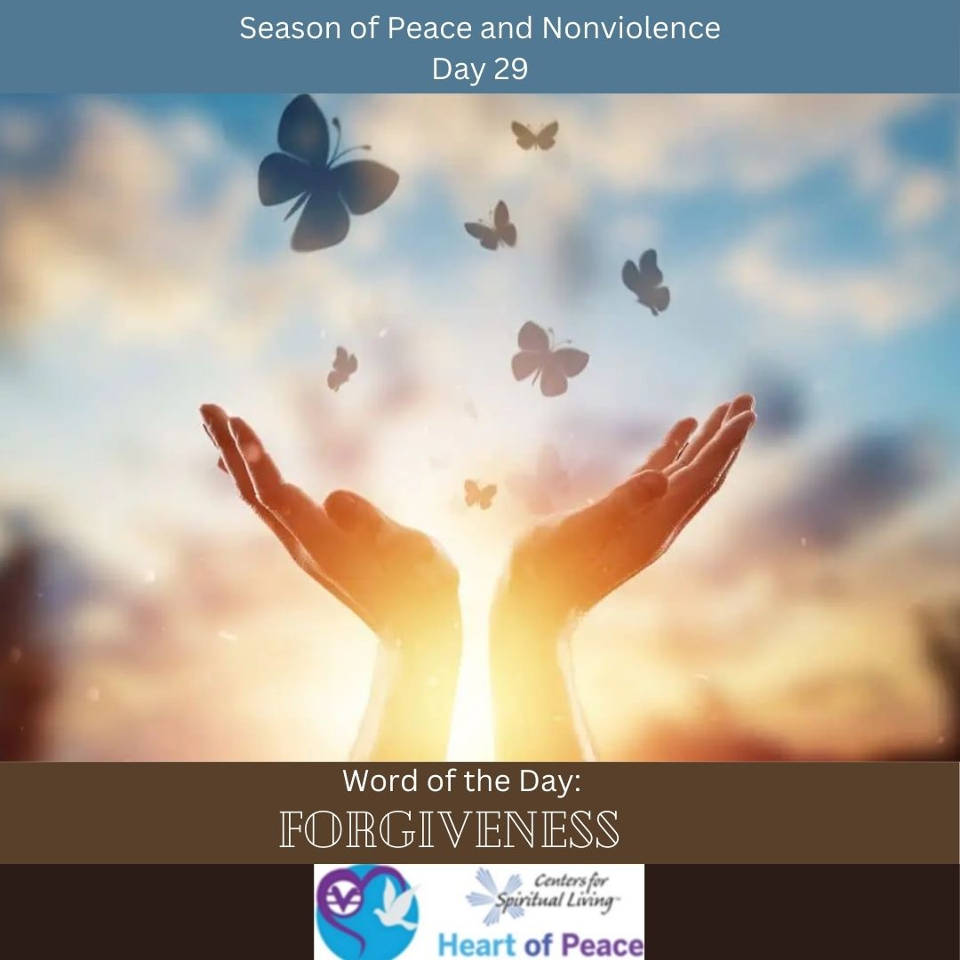
Day 29: Forgiveness
Why is forgiveness important?
Who in your life do you most need to forgive? What has been blocking you?
Can you forgive someone you have never met?
How can you forgive someone who continues to do the same things?

Slide 3

Day 30: Amends
What does it mean to make amends?
Most people associate making amends with a 12-step program. Are amends still important if you are not in a 12-step program?
How do you know who you owe an amends to?
How do you handle if your amends are not accepted?
What steps are you willing to take to start making amends?

Slide 4

Day 31: Praising
Who are you praising?
Does praise need to be earned?
Why is praising important?
How does praising other’s affect you?
How do you handle if someone cannot accept praise?

Slide 5
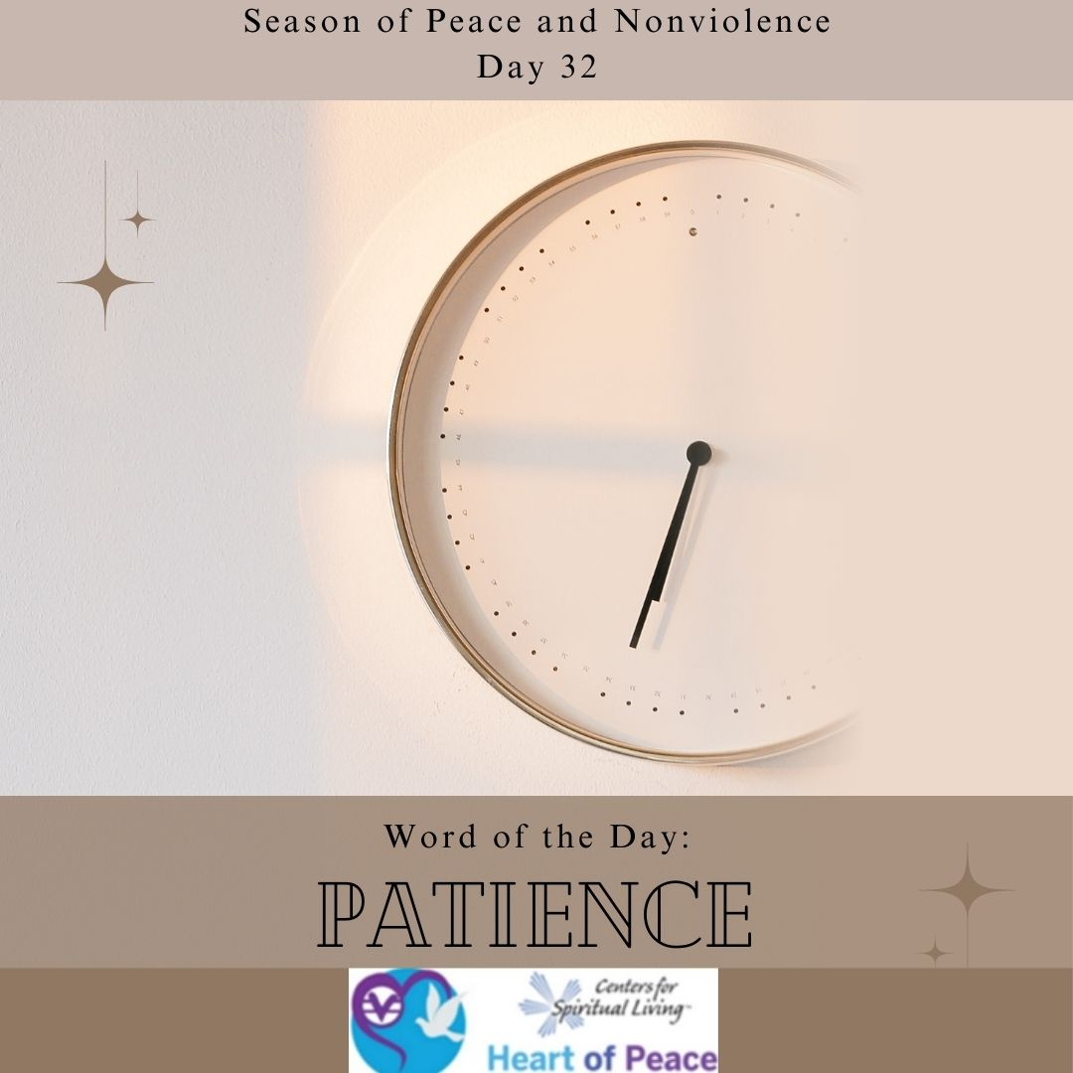
Day 32: Patience
What does it mean to be patient?
Why is patience important?
Who or what tries your patience the most?
How do you learn to be more patient?

Slide 6
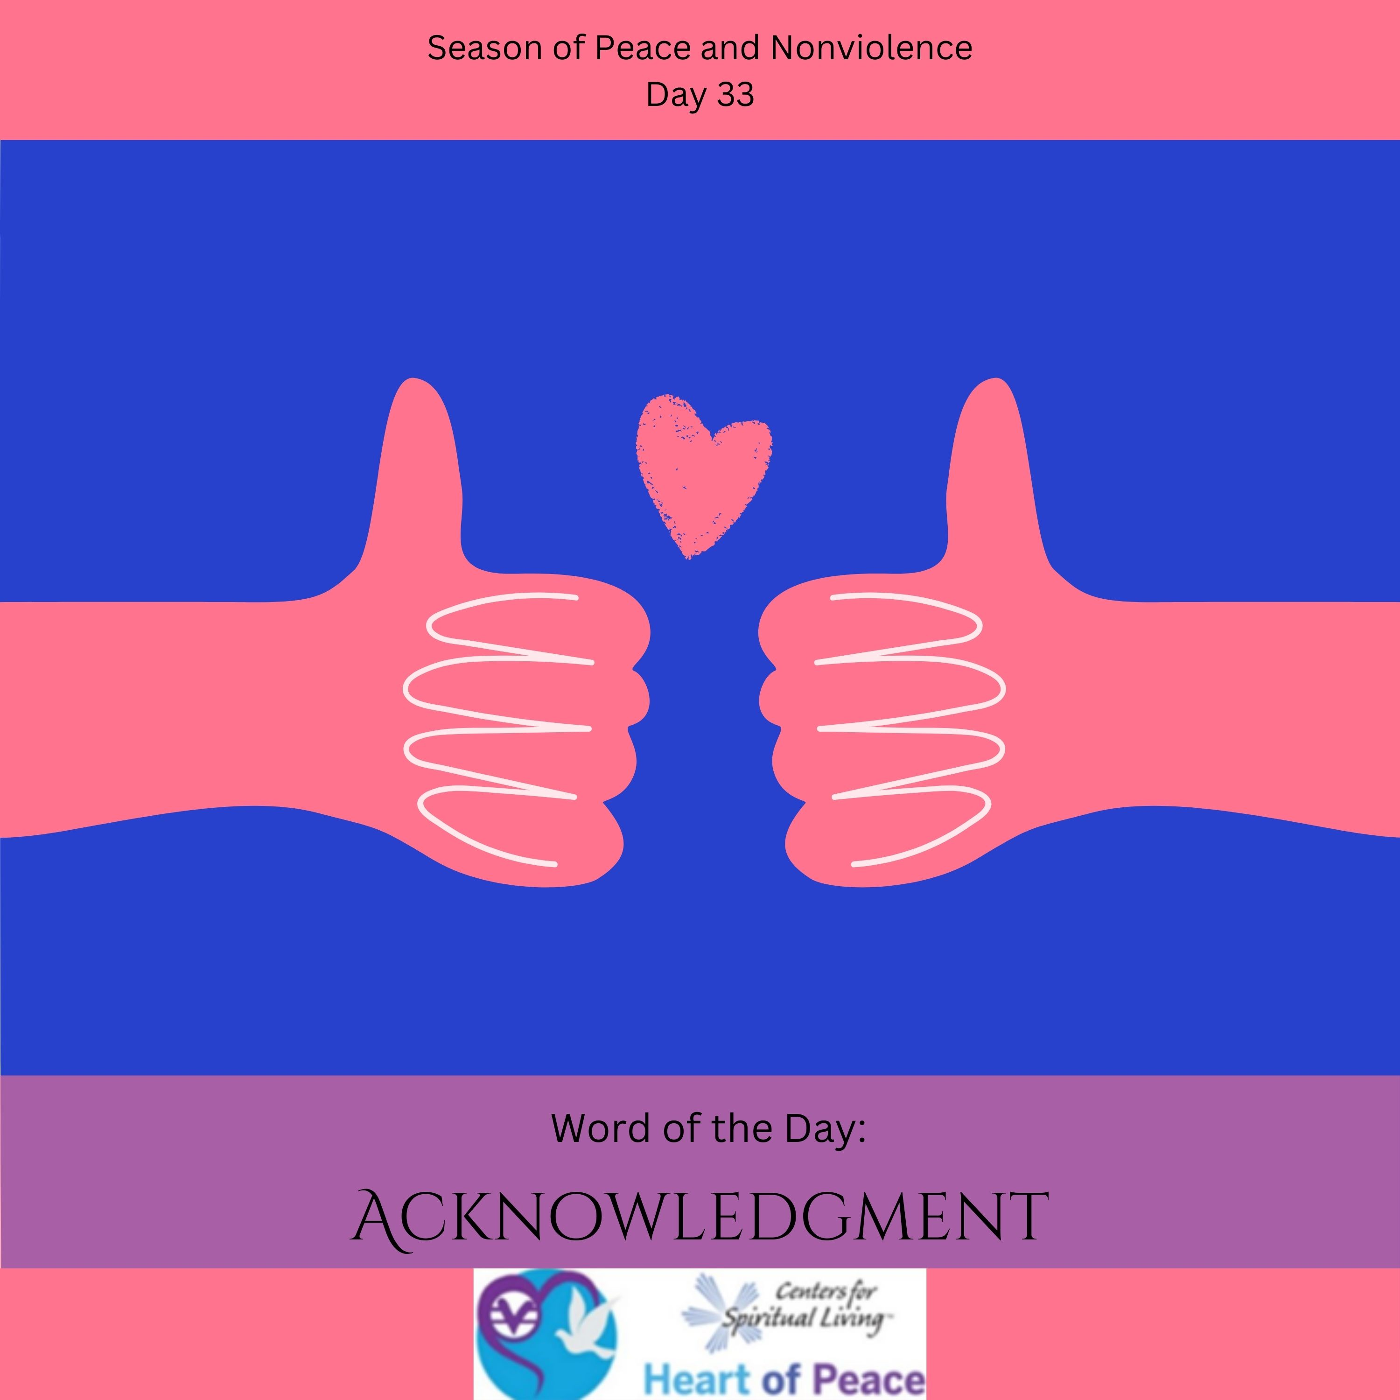
Day 33: Acknowledgment
What in your life needs acknowledgment?
What challenges do you have in acknowledging the good in your life?
What effects on your relationships can acknowledgment have?
What steps are you committed to taking to increase acknowledgment in your life?

Slide 7
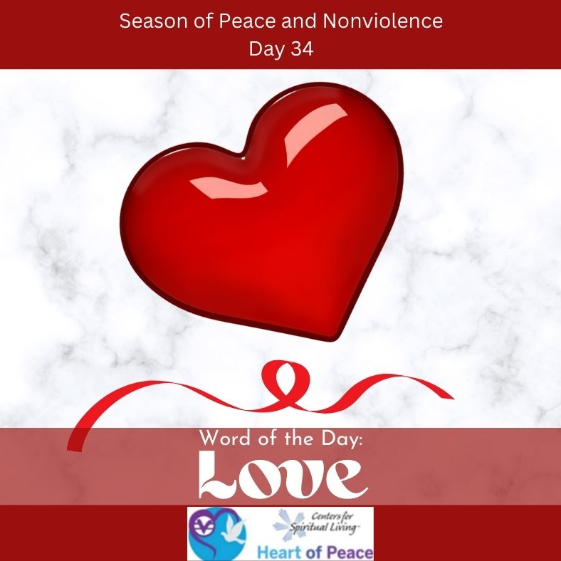
Day 34: Love
What is love?
How do you show yourself love?
How do you show love to others?
How do you love people when you don’t always like them?
What changes can you see in the world with more love?

Slide 8
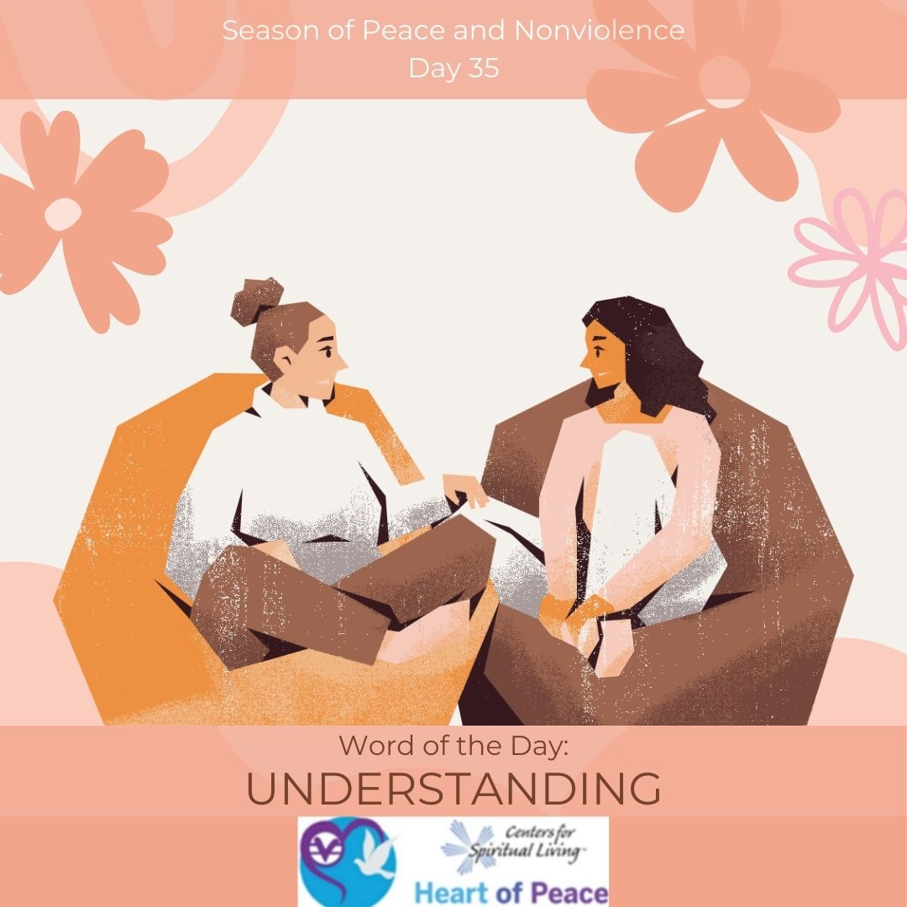
Day 35: Understanding
Where is it hardest for you to be understanding?
What do you do when you feel you are not being understood?
How do you gain better understanding with someone who you don’t understand or relate to?
What steps are you willing to take to become more understanding in difficult situations?

Slide 9
Summary Questions
How do this week's words apply to peace and nonviolence?
What challenges do this week’s words bring up for you?
What words do you feel you need to spend more time with?
What would help you most in incorporating these words in your life?

Slide 10
Week 5 Words- Added Resources
Day 29 – FORGIVENESS (Feb. 27) - Gandhi said, "If we practice an eye for an eye and a tooth for a tooth, soon the whole world will be blind and toothless." When you release a hurt, you can lighten your burdens. Think of someone who has wronged you. You don't have to forgive the action, forgive the person. Recognize their divine self. Share the story with a friend. Share forgiveness.
Day 30 – AMENDS (Feb. 28)- Making amends means apologizing to someone you hurt and really meaning it. Think of someone you have hurt. Today, consider making amends to this person. A huge burden will be lifted off both of you. This simple act can heal relationships.
Day 31 – PRAISING (March 1)- Mark Twain said: "I can live for two months on a good compliment." Appreciation makes people grow. Appreciate the people around you today. Don't be shy. Let them know.
Day 32 – PATIENCE (March 2)- What really drives you insane? Your parents, brothers and sisters, a certain friend? Today, practice patience with these challenging people or situations in your life. Take deep breaths if you have to. Being patient is a powerful act of nonviolence. Notice how the situation gets worse when you fly off the handle. Try to control your reaction to annoying situations in your life. Notice the different response you get when you are patient.
Day 33 – ACKNOWLEDGEMENT (March 3)- People make a difference every day. Who makes a difference in your life? Tell this person if you can. It feels really good to be truly acknowledged. Tell them how they helped you and thank them. It is also important to acknowledge yourself. Focus on the good in yourself and others today, and share it.
Day 34 – LOVE (March 4)- Gandhi wrote, "Nonviolence is based on the assumption that people respond to love and kindness." Take a moment and think about those who love you, and how that love makes you feel. Try to really express your love to others today. There is no need to hold back. We all need love.
Day 35 – UNDERSTANDING (March 5)- The Vietnamese teacher Thich Nhat Hanh says,” When you understand, you cannot help but love." Instead of letting words go in through one ear and out the other, take a moment to hear what the person is saying. Try to be the person that actually listens. Send every stranger you meet today a silent (to yourself) “I love you” thought.
Document Source: Microsoft Word - 64-Daily_Practices-TEENS.doc

